Slide 1
Prepared for:
ANY FAMILY RESIDENCE
1234 Main Street | Any Town | USA 00000

Slide 2
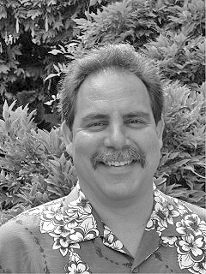
Realtor® profile
Call Realty Company
433 Via Corta
Palos Verdes Estates, CA 90274
www.bestpalosverdeshomes.com
310.346.6467
george.fotion@homeispalosverdes.com
Licensed since May 1980 BRE # 785373
Double Major B.A. in Econ & Psych
Multi Award Winning Marketing Broker for National Relocation Companies
Palos Verdes Specialist Certification
The MISSION is simple … implement strategies & tactics to create a “gravity well” of demand for you home in a compressed period of time thus causing your home to sell faster and for its highest possible market price.

Slide 3
Community involvement
Palos Verdes Education Foundation
Wounded Warriors Project

Slide 4
My Recent sales
I would be happy to furnish an updated list. Email me for latest list
3

Slide 5
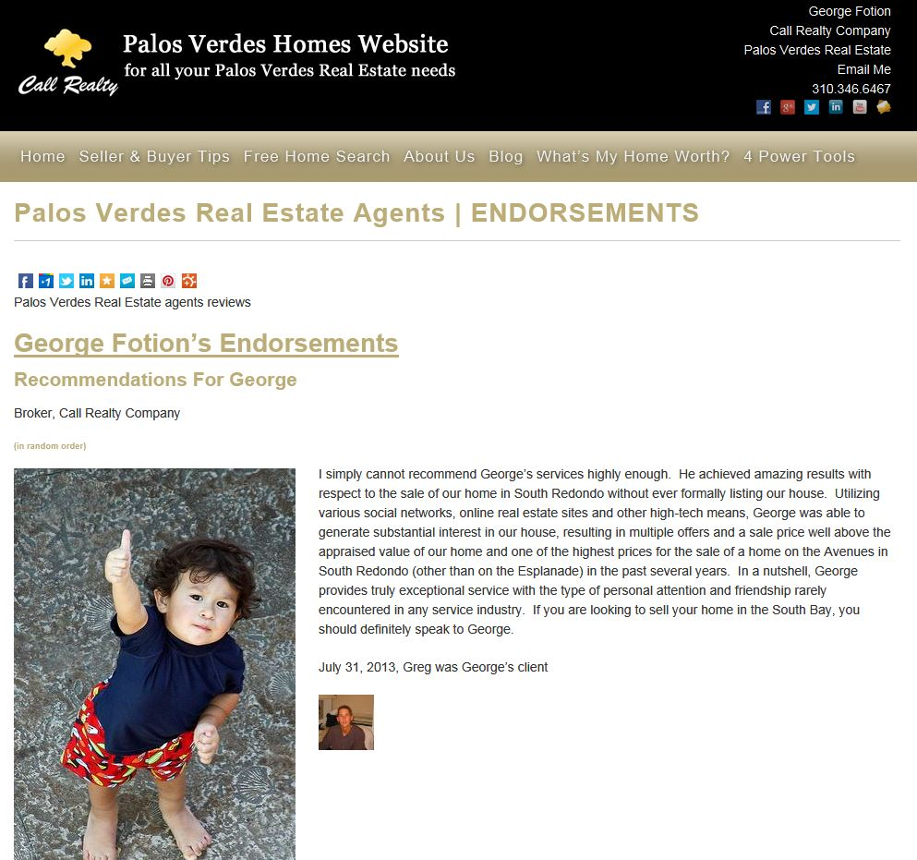
My testimonials
Please use this link to review

Slide 6
My awards and designations
Certified Palos Verdes Specialist
Recipient of “Perfect Review” by Traveler’s Relocation
Effectiveness Rating in the Top 1% of all Brokers in Palos Verdes

Slide 7
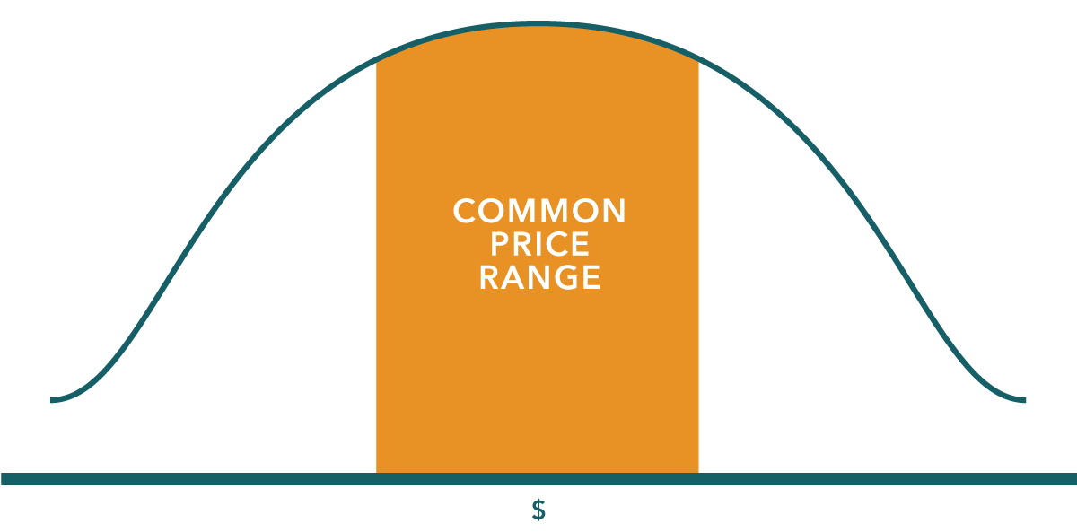
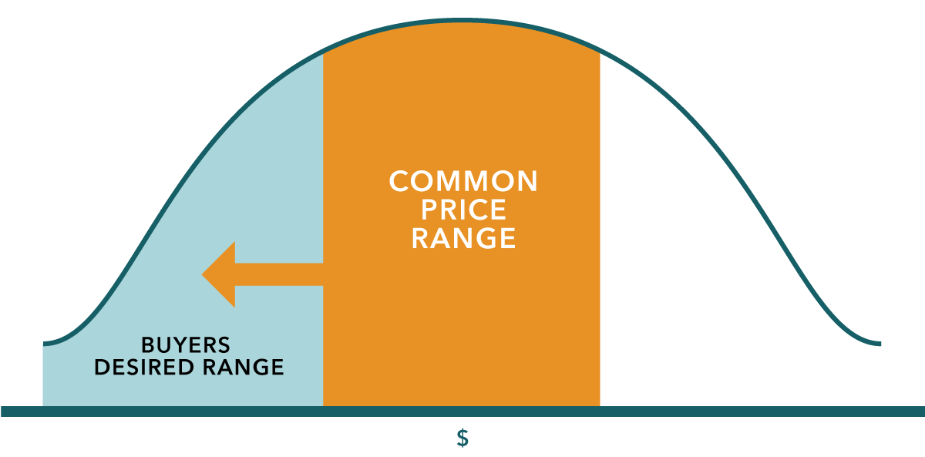
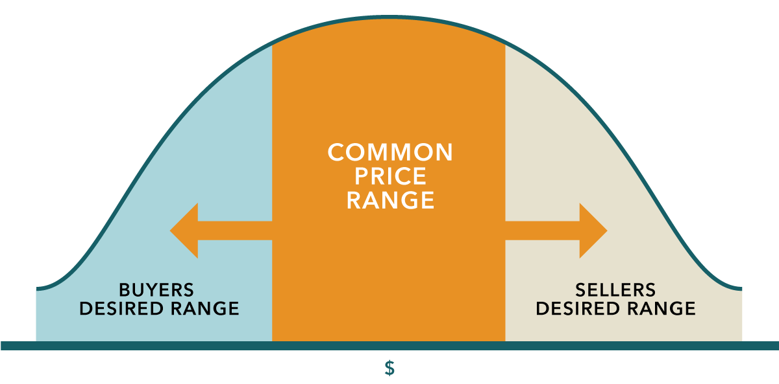
Asking price vs. selling price
Strategically pricing your home to get it sold for the most money in the least amount of time
Price too low and you lose the value.
Price too high and you lose the buyers.

Slide 8
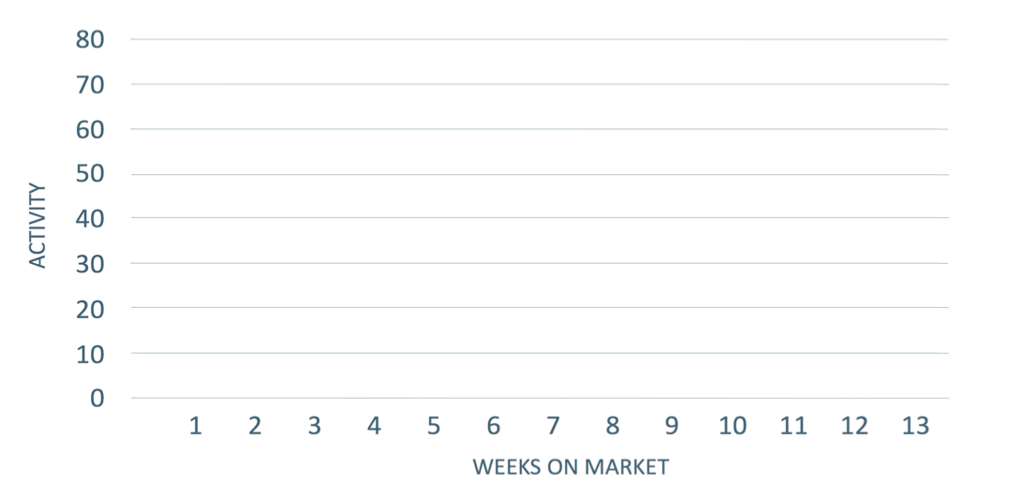
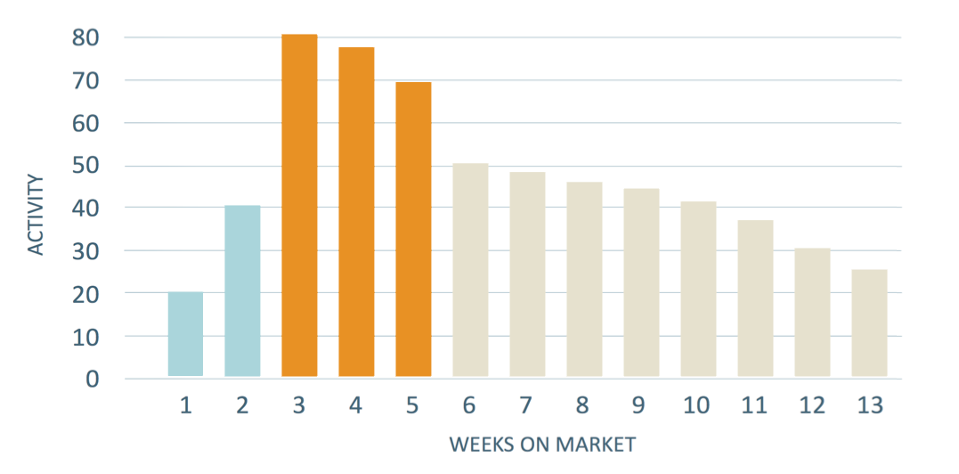
Critical weeks when listed
Pricing correctly helps you strike a deal when there is more competition for your home.
There’s something VERY wrong about this picture … do you know what it is? And, why do nearly every single agent not know about it or how to fix it?

Slide 9
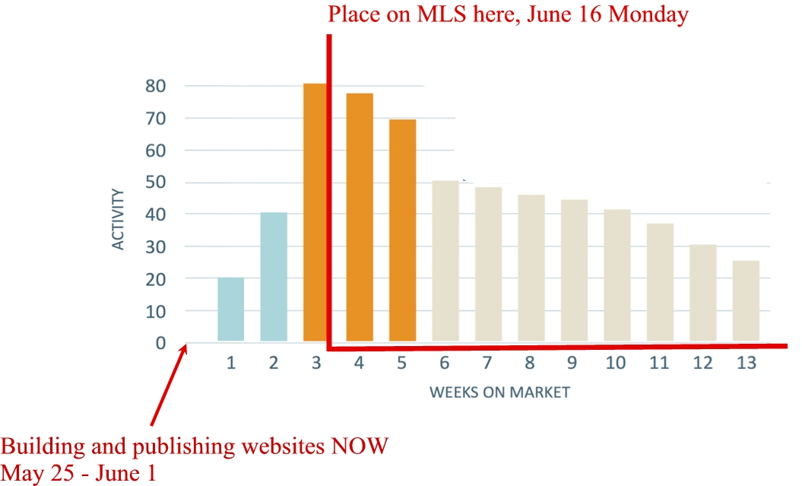
The Solution – “crescendo marketing™”

Slide 10
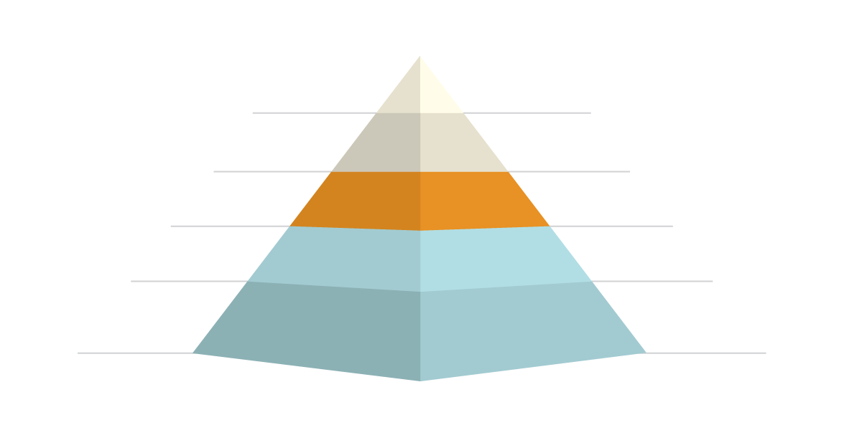
Pricing vs. potential buyers
Properly priced, you will have the possibility of
many more buyers competing for your property.
Asking Price Compared to Market Value
Percentage of Potential Buyers who will look for Property
+15%
10%
+10%
30%
Market Value
60%
-10%
75%
-15%
90%

Slide 11
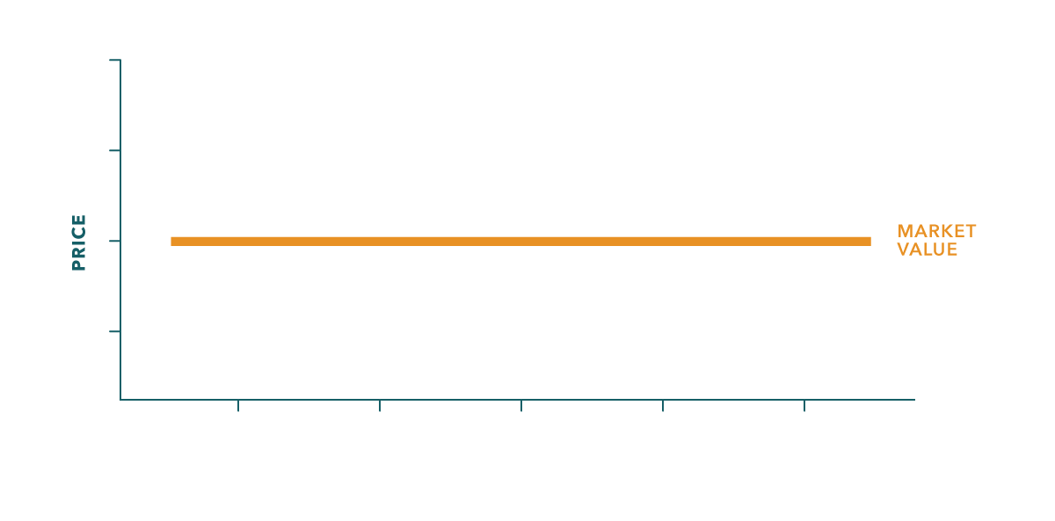
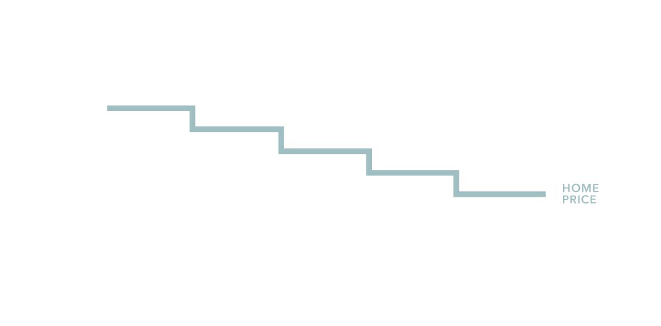
Importance of pricing
I will negotiate on your behalf to help get the best price at the best terms in the shortest amount of time.
Over time a home that has not been sold may attract offers below market value.

Slide 12
Recent sale comparables
A snapshot of comparable homes sold recently in your area.
Many buyers these days are using computer algorithms such as Zillow to get an idea of value.
You may have already received from me the following algorithms
HomeIsPV.SmartHomeValue.com
CoreLogic (from one of the nation’s largest title companies research division)
RPR (another independent real estate research think tank)
No computer algorithm can substitute however for a professional Realtor’s market value audit to help estimate what a buyer in today’s market will pay for your home.
3

Slide 13
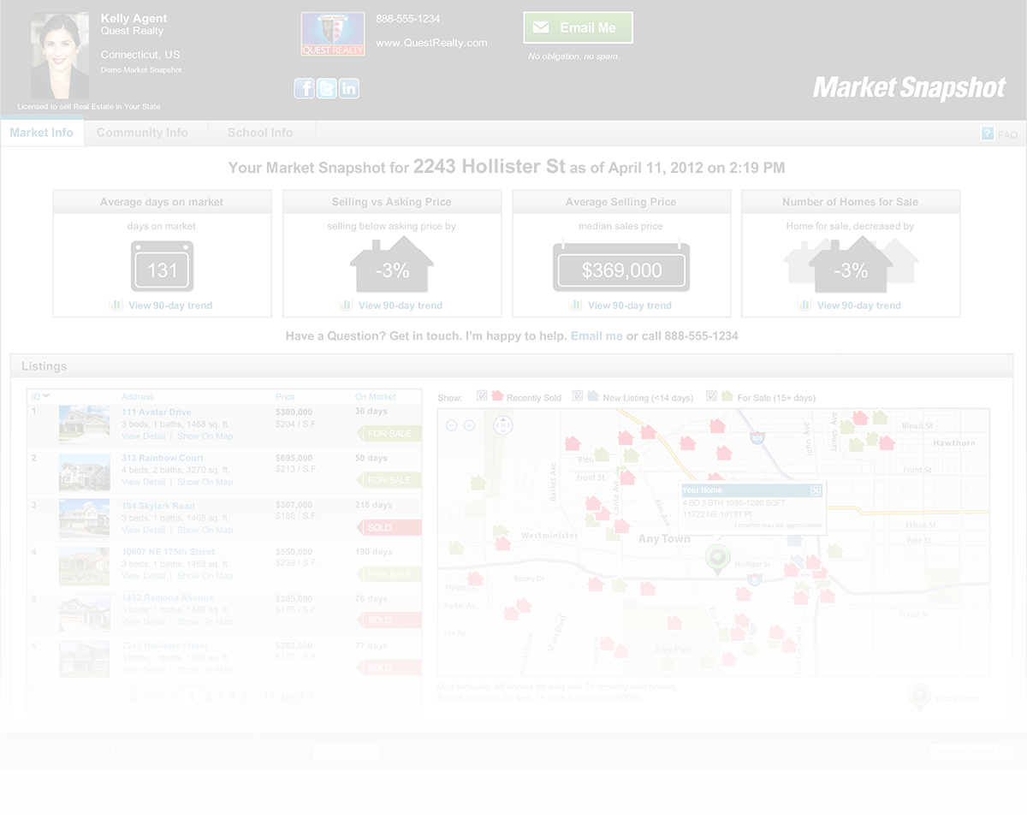
Competitive market analysis
Discussion of Market Value
3

Slide 14
Preview of your home
In addition to my efforts, the associates in my office may be assisting me in locating buyers, showing and selling your home.

Slide 15
Importance of internet home search
Home Buyers And Sellers
• 90% of home buyers and sellers use the internet to search for their home¹
• Reach the widest audience of potential buyers
• More buyers = better chance of finding one that is willing to meet your terms, price and desired closing date
90%
Source: National Association of REALTORS®, Profile of Home Buyers and Sellers, 2012

Slide 16
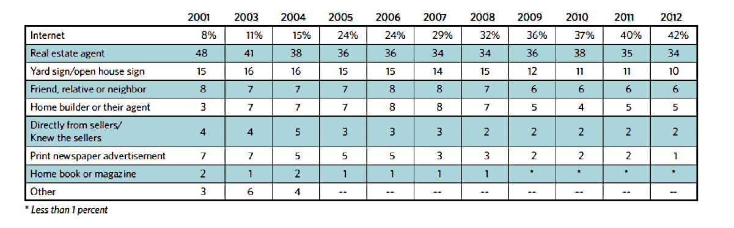
Where buyers find homes
42% of buyers found a home via the internet – up from 8% in 2001
Where buyers found the home they purchased, 2001-2012 (Percentage Distribution)
Source: National Association of REALTORS®, Profile of Home Buyers and Sellers, 2012

Slide 17
How buyers found their homes
• 2002: Internet surpassed print ads
Internet 42%
• 2004: More buyers found their home on internet than from signs
90%
Signs 10%
• 2009: The internet is THREE TIMES as powerful as signs
Print Ads 1%
Source: National Association of REALTORS®, Profile of Home Buyers and Sellers, 2012

Slide 18
Best of all worlds
I market to buyers who are on our site PLUS buyers who have not yet picked a broker.
Buyers who are just on
realtor.com®
Buyers search our local web site
Buyers who search our local site and realtor.com®
Print ads
For illustrative purposes. Varies by broker and region.

Slide 19
Facts that matter
Realtor.com® is the industry’s most engaging real estate search site.*
More Minutes
More Visits
More Pages Viewed

Slide 20
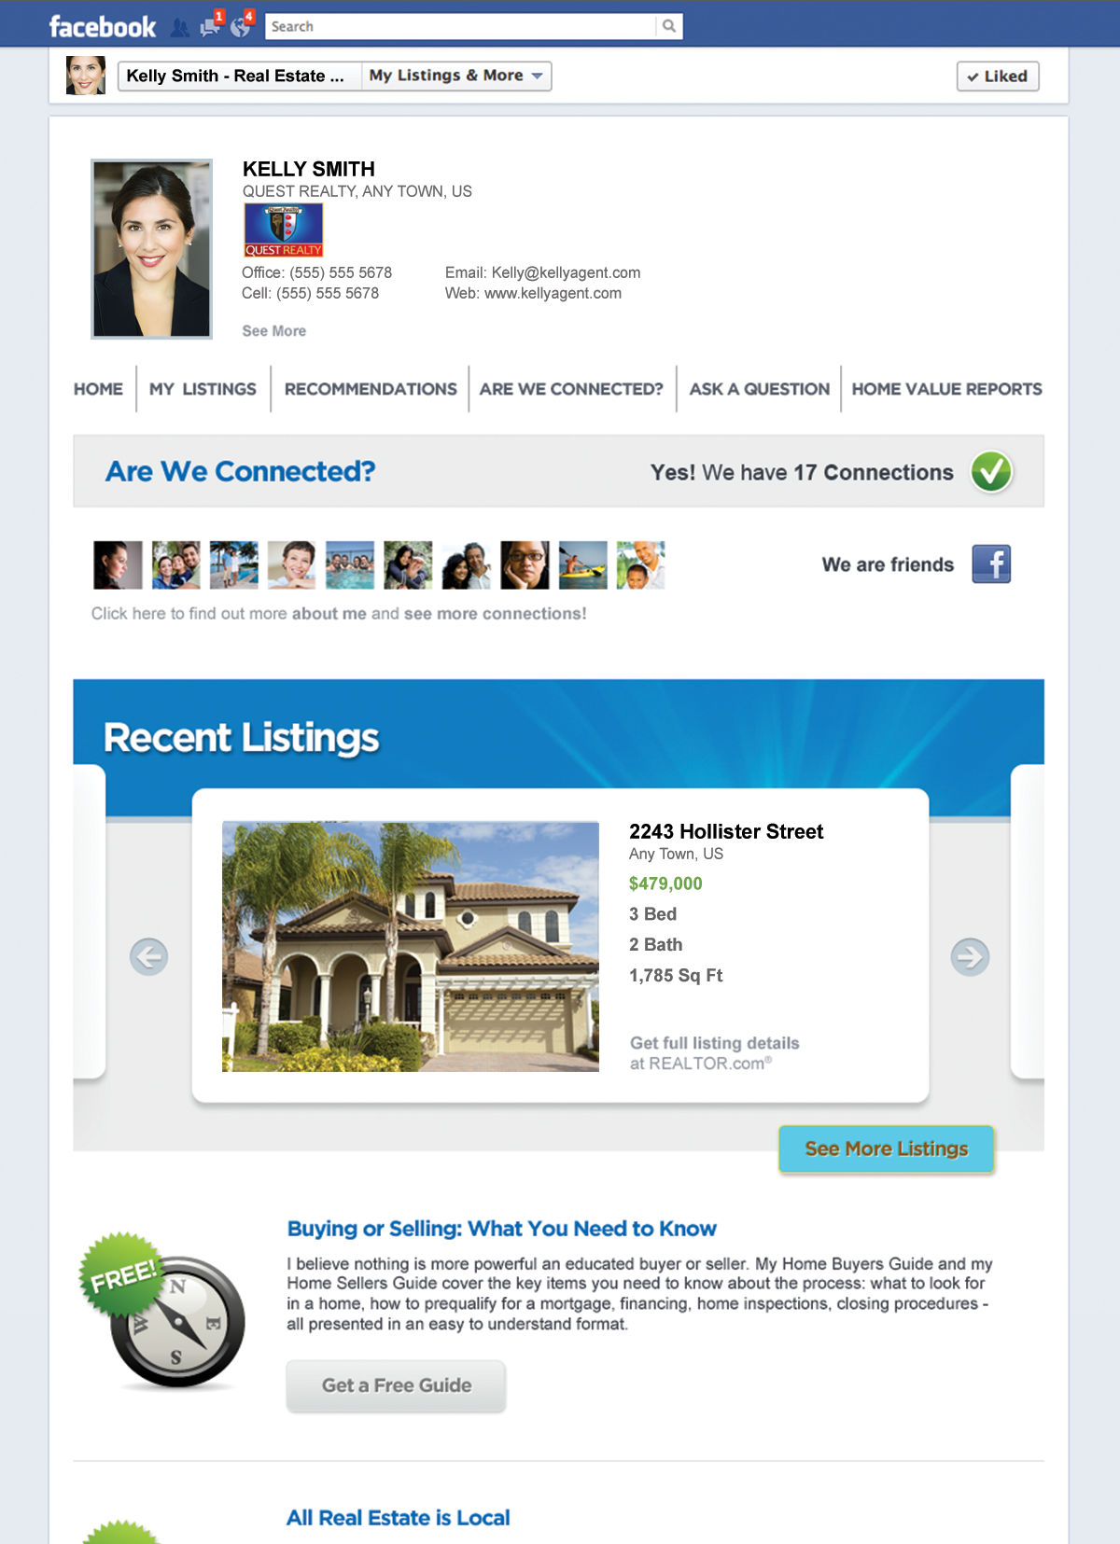
Social networking
I will use social networking as a non-intrusive way to keep my network apprised of your listing.
Screen shots represent site as of publication date. Site subject to change without notice.

Slide 21
Because realtor.com® has millions of listings
I will make YOURS stand out

Slide 22
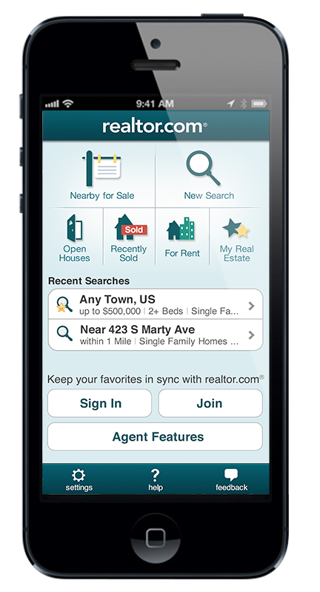
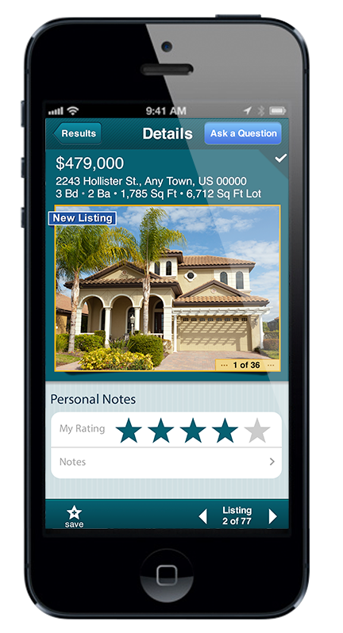
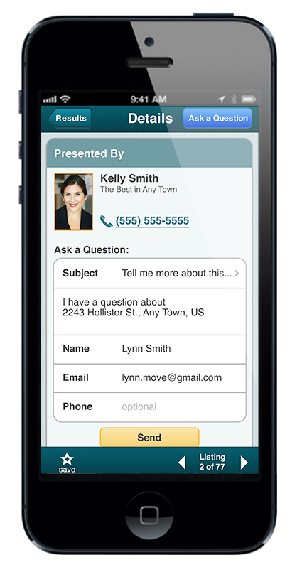
Realtor.com® apps
Mobile Marketing Plan
• Buyers driving through the neighborhood can:
- Find your home, get directions and a map
- Connect with me in one “click” to get details and make an appointment
Buyers who are searching in this neighborhood can find
me through realtor.com® mobile marketing.
Screen shots represent site as of publication date. Site subject to change without notice.

Slide 23
How will I showcase your home to the most buyers?
• I will help your home rise to the top of the search, above other homes, by adding more photos.

Slide 24
How will I showcase your home to the most buyers?
• I place my cell phone number at multiple points to increase buyer calls for your property.

Slide 25
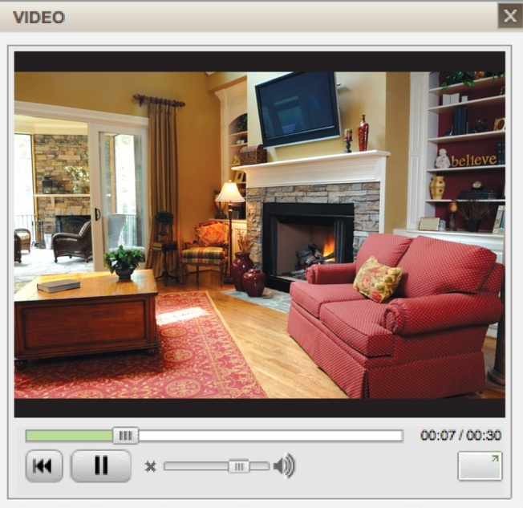
How will I showcase your home to the most buyers?
• I will make your home stand out with a video or virtual tour.
Nearly 180 million U.S. internet users watch videos on the internet every month¹
Screen shots represent site as of publication date. Site subject to change without notice.

Slide 26
Open Houses – what’s more effective, a traditional or “reverse” open house?
• Local and regional buyers make up half of the market.
• I will post your Open House on the website where more consumers are doing research.
• Those who know the neighborhood may refer their friends to your Open House.

Slide 27
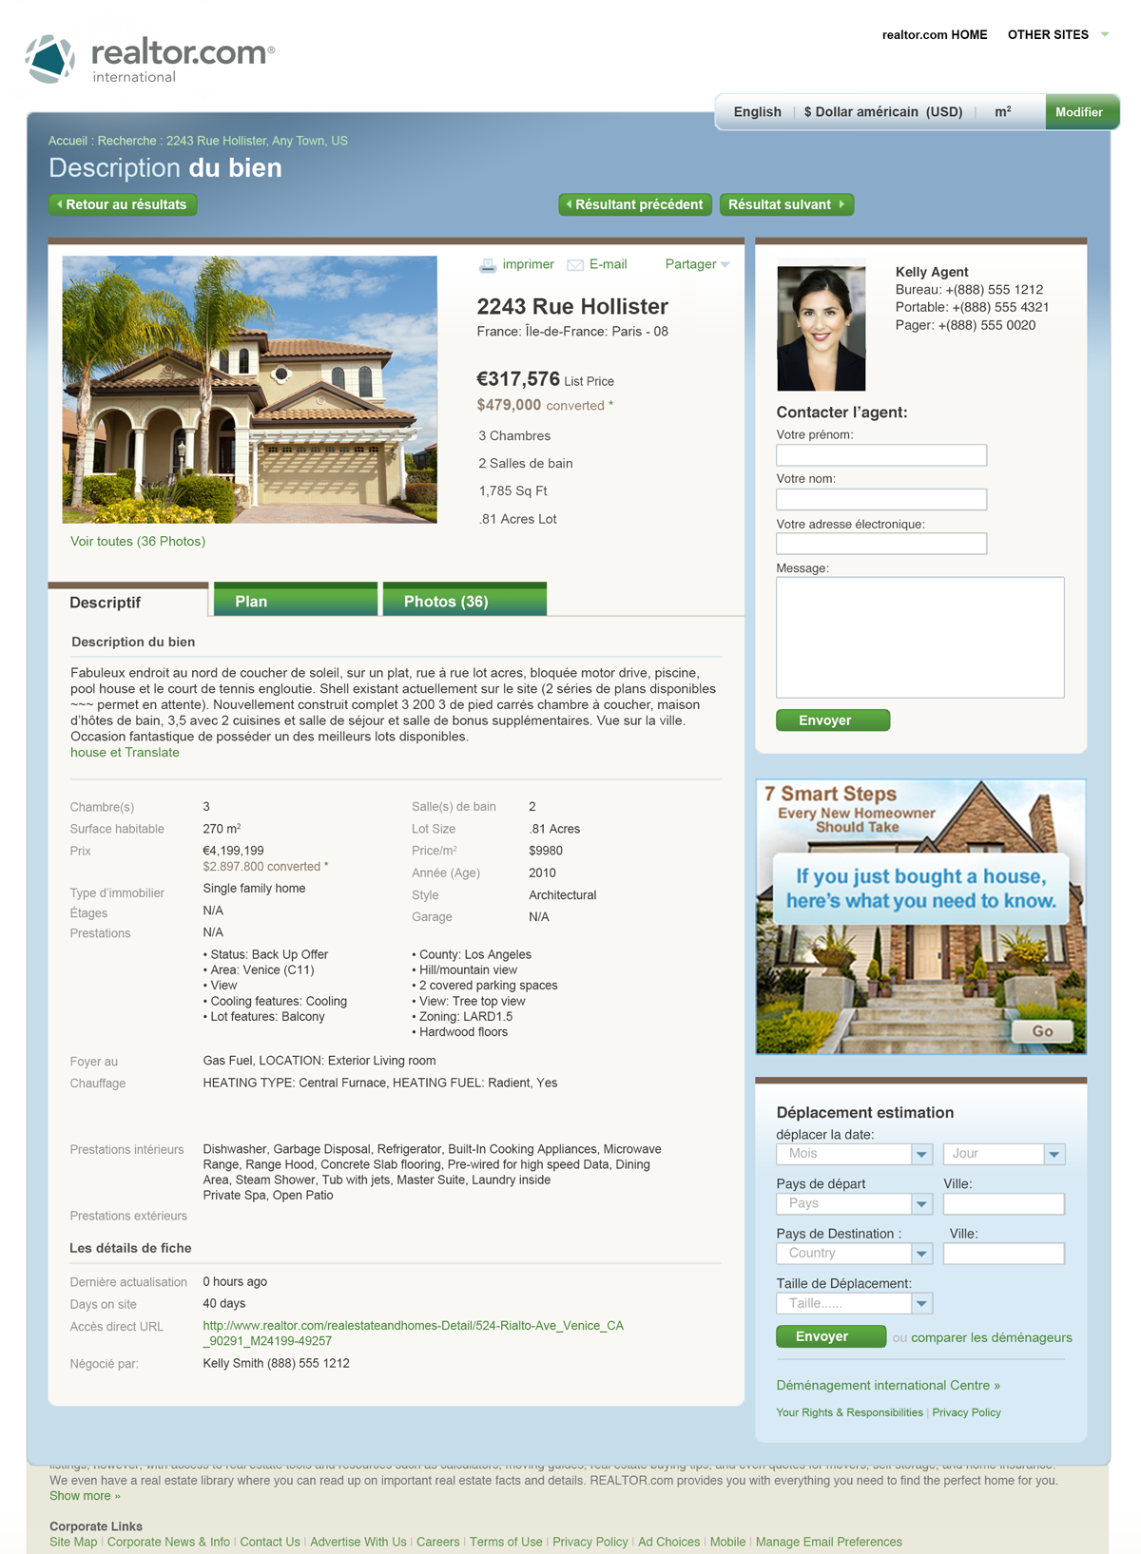
Realtor.com® brings international buyers to you
French
Chinese
Translated into 11 languages, the realtor.com® global site offers international and investment buyers the opportunity to view your listing in their native language.
Dutch
English
German
Italian
Japanese
Korean
Portuguese
Russian
Spanish
Screen shots represent site as of publication date. Site subject to change without notice.

Slide 28
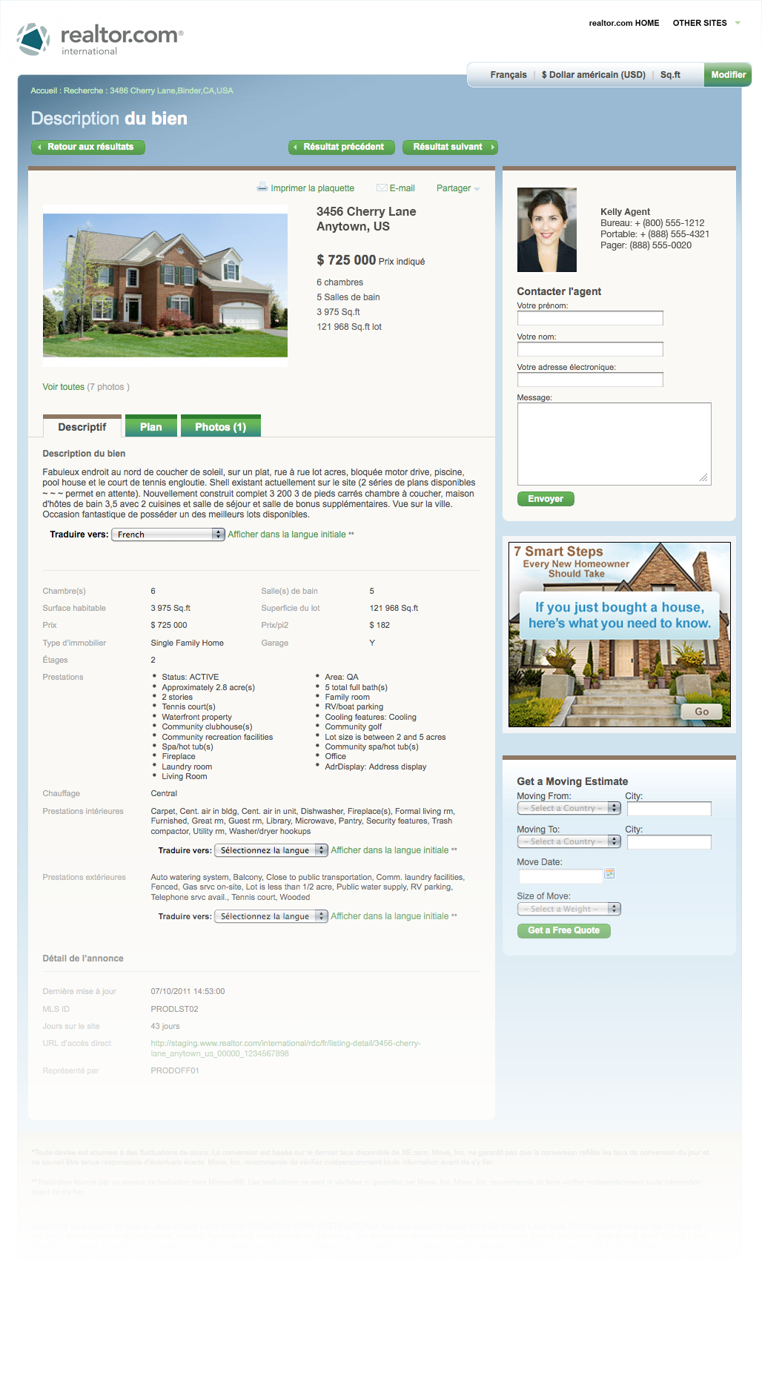
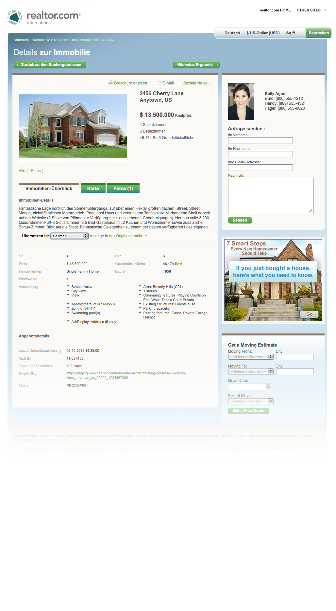
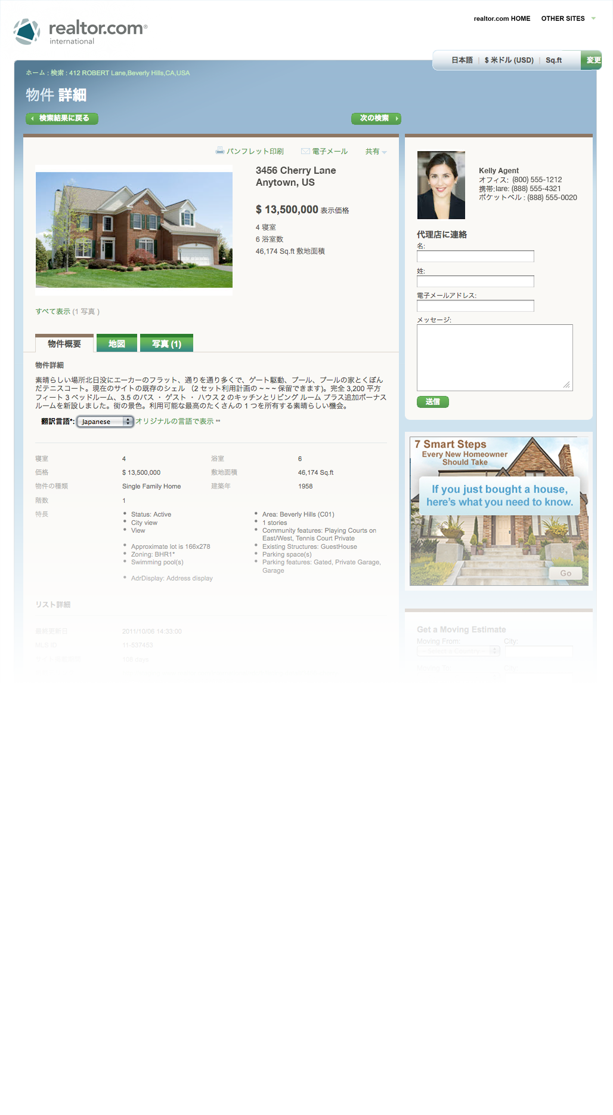
Realtor.com® brings international buyers to you
International buyers have an easy way to contact me with questions regarding your home.
Screen shots represent site as of publication date. Site subject to change without notice.

Slide 29
Online listing performance report
Realtor.com® tracking report shows how many buyers are looking at your home.
Screen shots represent site as of publication date. Site subject to change without notice.

Slide 30
Locally, regionally, nationally and internationally
• Move-up buyers
• First time homeowners
• Local buyers
• Relocation buyers
• Investors
• Foreign buyers

Slide 31
• I can make your home the first one buyers see
• Exclusive position gets your home seen before all others
Screen shots represent site as of publication date. Site subject to change without notice.

Slide 32
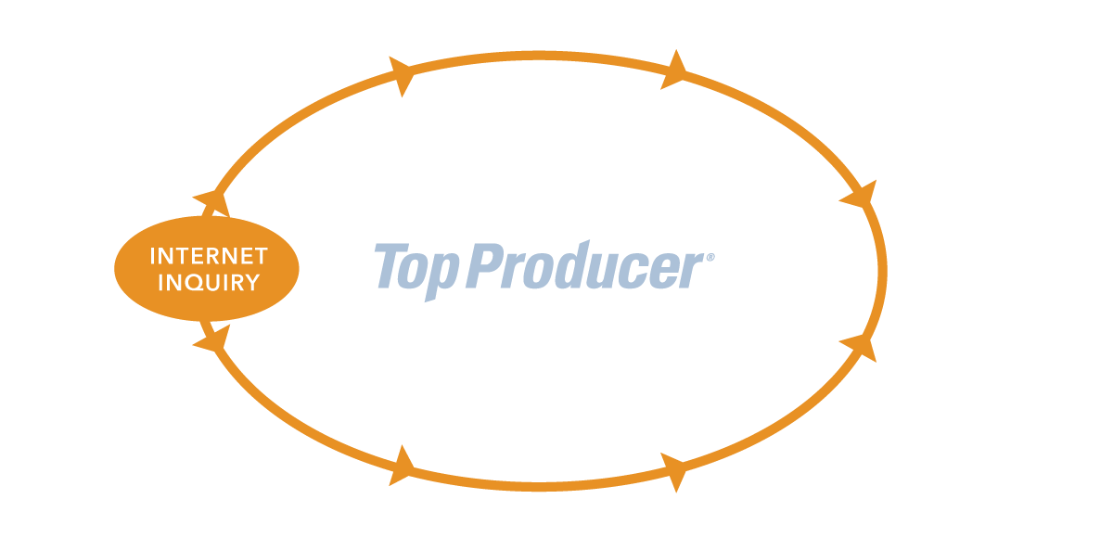
Top producer®
Top Producer® CRM helps convert more internet buyers

Slide 33
Online marketing advantage
Showcase℠ Listing Enhancements
I will enhance your listings on the top websites, including realtor.com®, with the features buyers want most
Featured Homes℠
Your home will have premium positioning on the most engaging real estate site,¹ realtor.com®
Mobile Reach
Your property will appear on the realtor.com® mobile apps so mobile consumers can find your home
Facebook Application
I will display your property on my social media sites such as Facebook and Twitter
Top Producer® CRM
My data system helps manage prospective buyers so that I never miss an inquiry, request or referral
¹ comScore, Media Metrix, key measures report, Jan-Dec 2012

